Slide 1
Pediatric epilepsy surgery for hemispheric lesions
Ammon’s Horn, Epilepsy Foundation
Maksim Parfyonov, MD FRCPC
Cleveland Clinic Epilepsy Center

Slide 2
“Sofia”
specific

Slide 3
Sofia
Term delivery, normal development
Seizure onset at 11 months
Developmental plateau with frequent daily focal motor seizures
Resistant to multiple medications (VPA, CLOB, LAC, PHT)
Notes:
Term delivery, normal development
At age 11 mo. began having frequent seizures characterized by eye opening/blinking, guttural noises, drooling and gagging, change in breathing, stiffening and loss of awareness.
Initially, well-controlled on VPA for 6-8 months but developed hyper-NH3 and had to be weaned
After onset of seizures, development plateaued with GDD - few words, manual stereotypies. No motor concerns.

Slide 4
Sofia
Seizure semiology evolved over time, and she developed generalized/axial tonic seizures with eye blinking, face twitches, ending with clonic jerks
At 3 years old, presented to Cleveland Clinic for second opinion.
Family interested in surgery with goals to “stop the seizures” and “improve development”
Notes:
…. she was presented to our epilepsy surgery conference. And I’ll show you her investigations

Slide 5
EEG - Interictal

Slide 6
Notes:
Not sure what the constitution of the audience here is, but for the trainees who may be unfamiliar with EEG, we are looking at a bipolar longitudinal montage here.

Slide 8
Typical Seizure

Slide 9
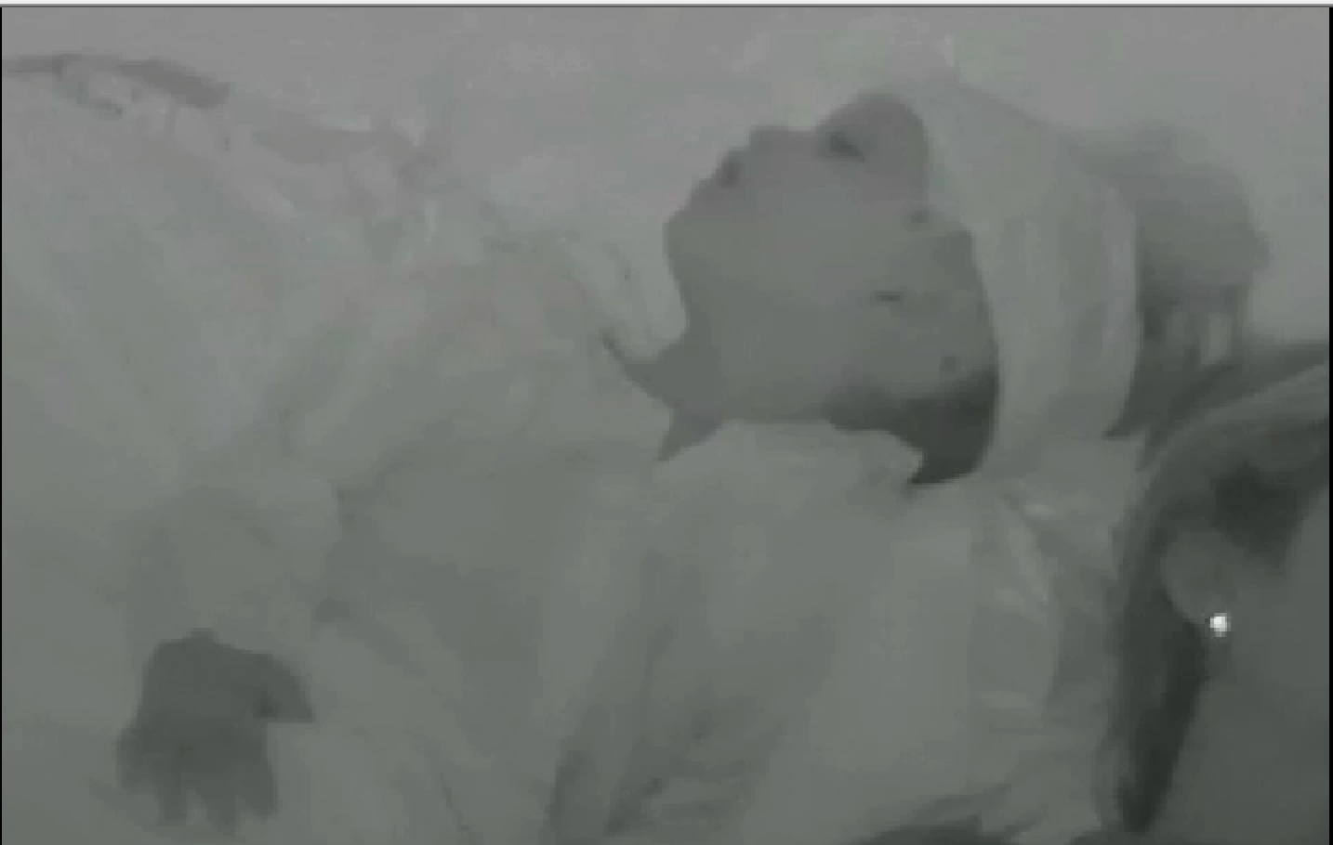
Notes:
From sleep. Abrupt axial and arm stiffening bilaterally for 10-15s. Eyes open and blink, gasping sound. Followed by subtle clonic movements in the right arm and leg.

Slide 10
EEG - Ictal

Slide 11
Notes:
From sleep. Abrupt axial and arm stiffening bilaterally for 10-15s. Eyes open and blink, gasping sound. Followed by subtle clonic movements in the right arm and leg.

Slide 15
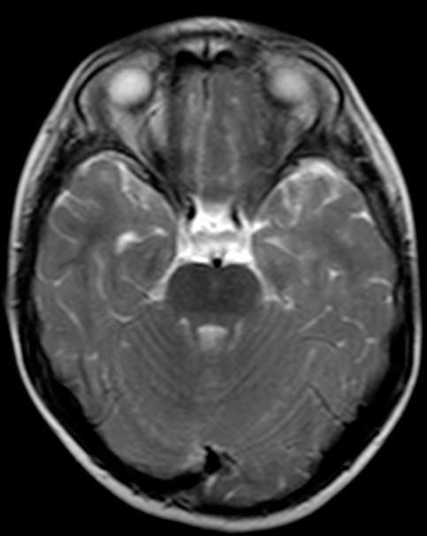
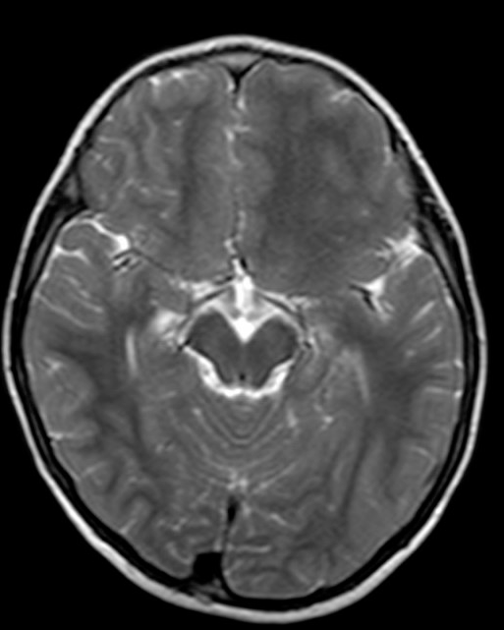
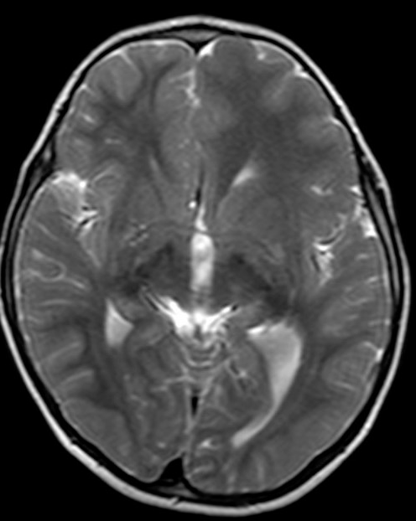
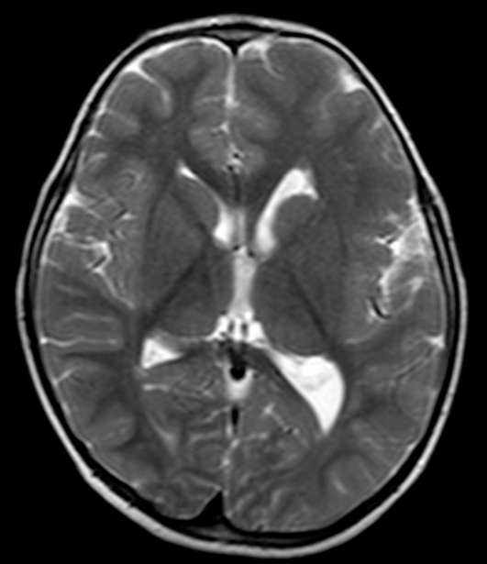
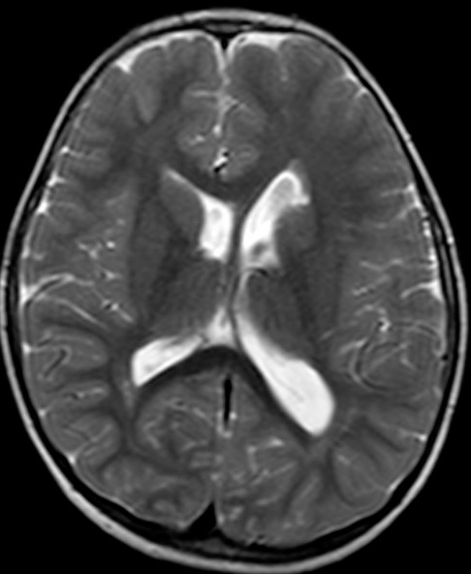
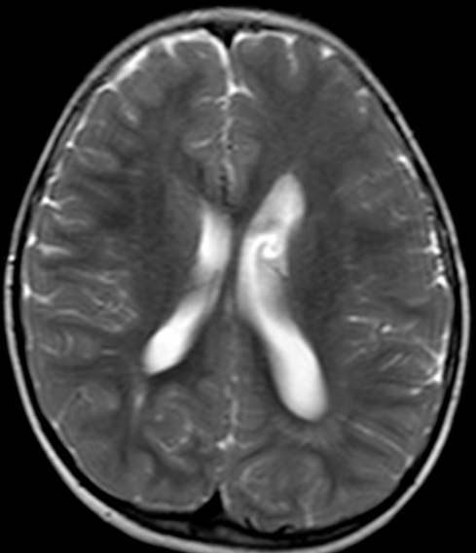
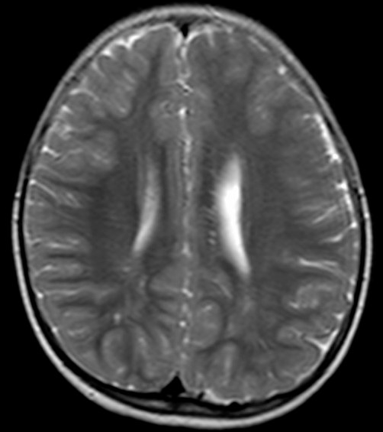
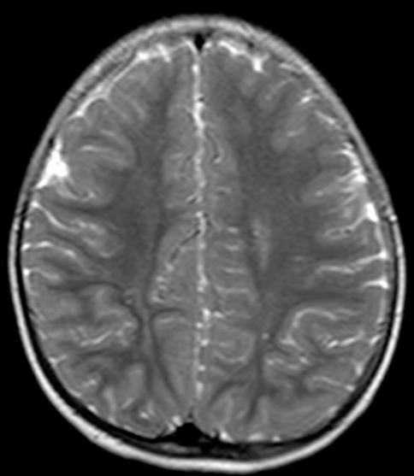

Slide 16
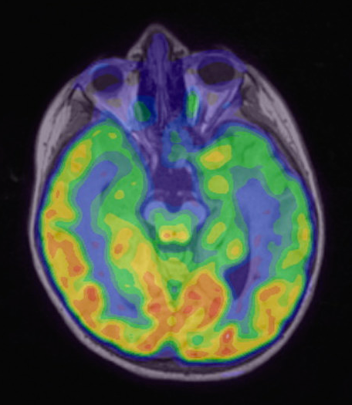
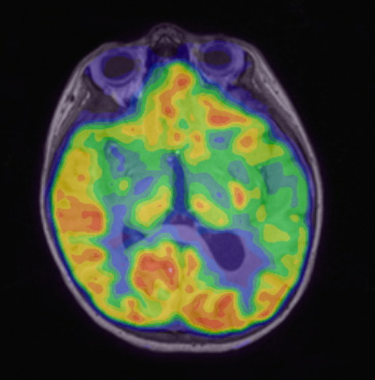
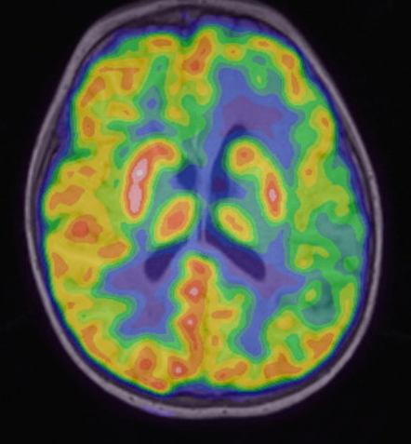
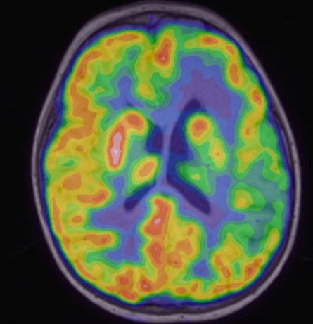
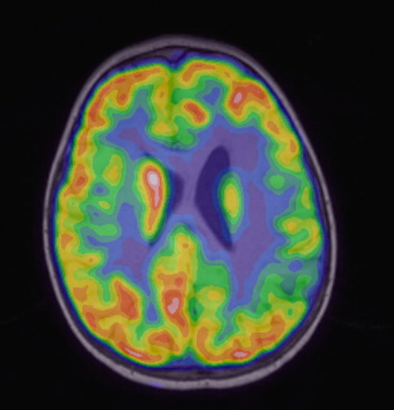
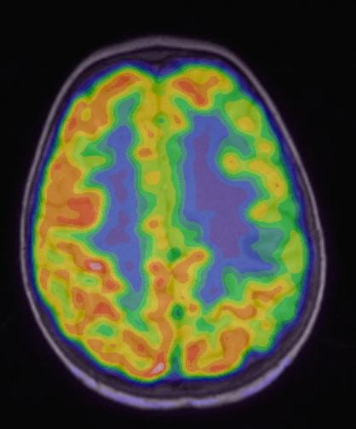
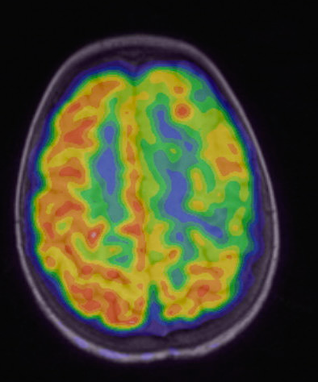
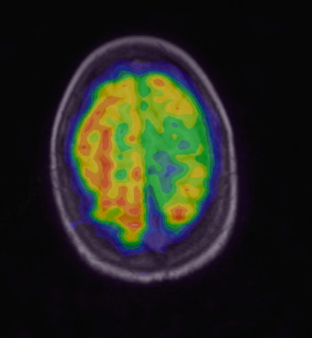

Slide 17
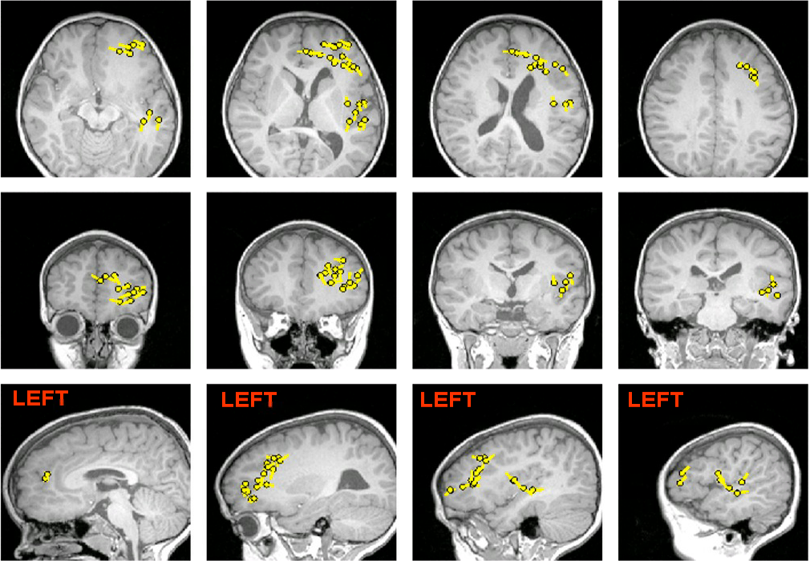

Slide 18
Patient Management Conference
Smaller Resection
Hemisphrectomy
MRI - Frontal
More Likely to Achieve Seizure Freedom
Dominant left frontal epileptogenicity
Difficulty in Delineating Extent of Lesion
Notes:
… we’ll leave the case here for now, but we will return later in this talk.

Slide 19
Patient Management Conference
Smaller Resection
Hemisphrectomy
Preserved Motor Function / Parent’s Decision
MRI - Frontal
More Likely to Achieve Seizure Freedom
Dominant left frontal epileptogenicity
Difficulty in Delineating Extent of Lesion

Slide 20
Patient Management Conference
Smaller Resection
Hemisphrectomy
Preserved Motor Function / Parent’s Decision
MRI - Frontal
More Likely to Achieve Seizure Freedom
Dominant left frontal epileptogenicity
Difficulty in Delineating Extent of Lesion

Slide 21
Surgery
Left frontal lobectomy using stereotactic localization and intraoperative electrocorticography
Pathology confirms diagnosis of focal cortical dysplasia
Acute post-op seizures in the hospital, was seizure free for several months then recurrence
Notes:
focal cortical architectural disorganization with neuronal cytomegaly and dysmorphic neurons. 90582254

Slide 22
Points for reflection
Excellent outcomes with hemispherectomy
Discussion becomes difficult when children have mild or no hemiparesis
Parents suffer with weighing unpredictable daily seizures and stagnating development against causing permanent (but stable) deficits

Slide 23
Unanswered questions
How often do we encounter such discussions in PMC?
What are the long-term outcomes of patients who have limited resections? How many fail and go on to re-operation?
What factors could predict outcome?
Notes:
First point - in my own experience while attending 7 hours of PMC every week, it seems not infrequent.
… this inspired me to look embark on a retrospective study looking at the experience at the Cleveland Clinic.

Slide 24
Pediatric epilepsy surgery for hemispheric lesions: HEMIspherectomy vs Smaller LIMited resections

Slide 25
Study Aims
Compare the long-term seizure outcomes of children who have undergone hemispherectomy or multilobar/lobar resections, in whom both options were discussed during PMC
Compare the long-term seizure outcomes in these groups
Elucidate any prognostic factors and potential predictors that may influence outcome

Slide 26
Inclusion Criteria
Retrospective chart review
Have undergone epilepsy surgery
Pediatric patients ≤ 18 years old
Original PMC features a discussion around hemispherectomy vs a limited resection

Slide 27
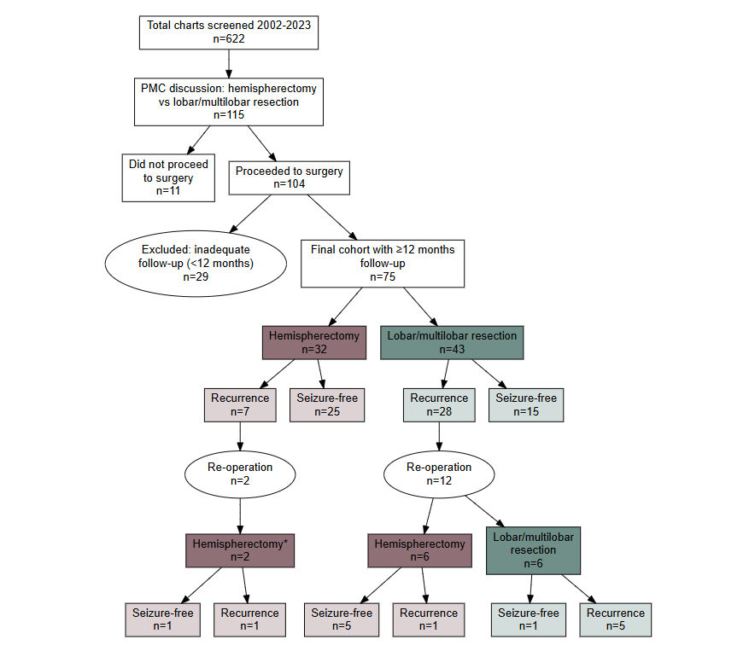

Slide 28
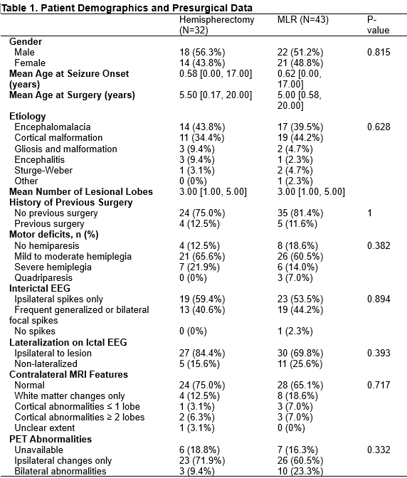
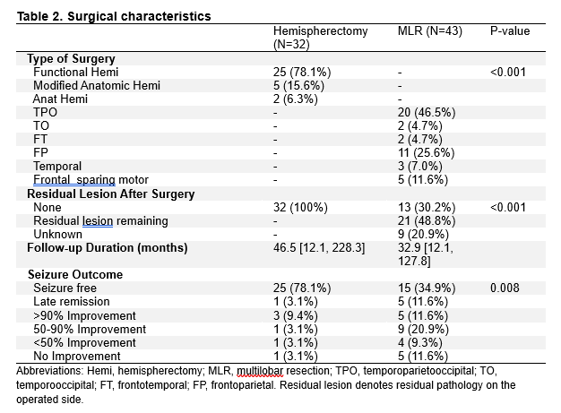

Slide 31
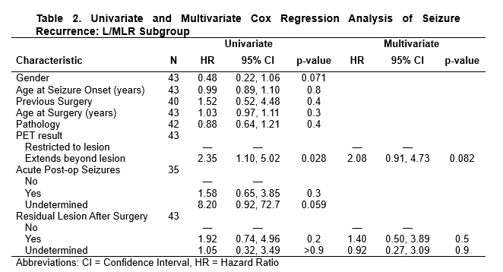

Slide 33
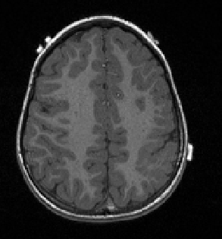
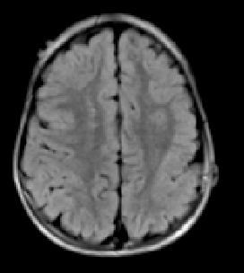
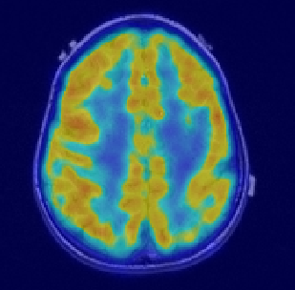
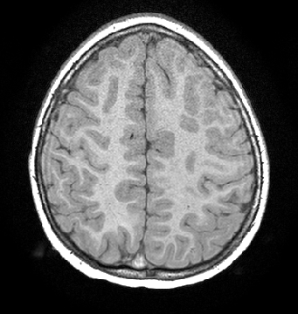
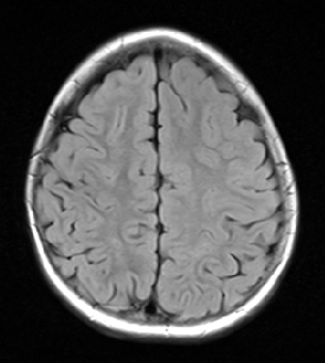
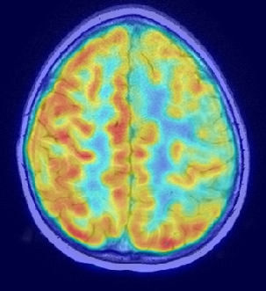
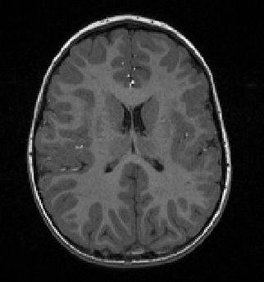
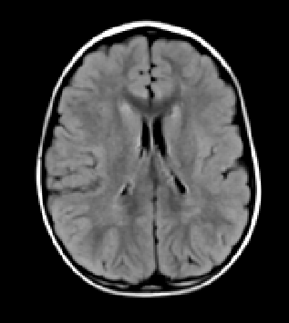
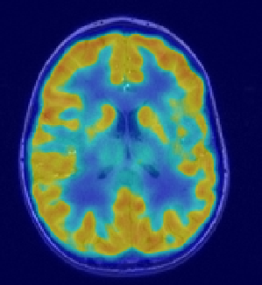
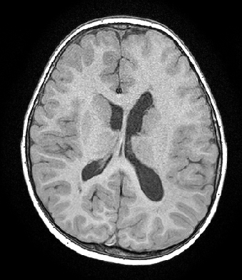
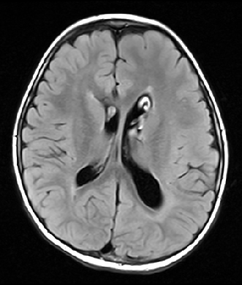
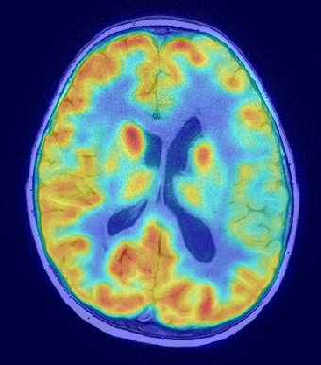
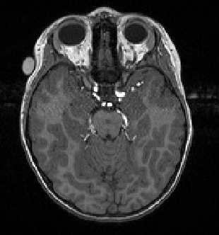
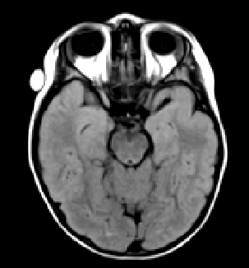
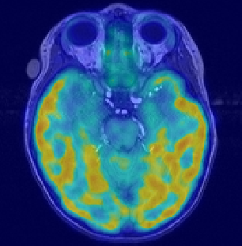
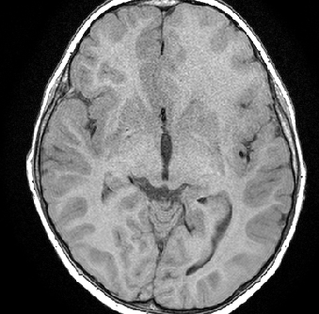
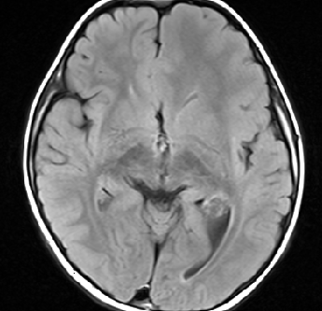
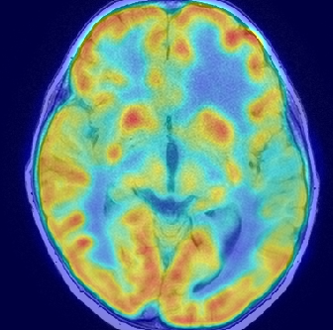
Patient #1
Patient #2
R
L
R
L
R
L
R
L
R
L
R
L
Notes:
Figure 4. FDG-PET hypometabolism relative to resection boundary predicts surgical outcome.
Axial T1-weighted MRI (left column), FLAIR MRI (middle column), and FDG-PET (right column) coregistered to T1 and shown at three representative levels for each patient. Dashed white lines demarcate the surgical resection boundary. Patient #1: A 5-year-old left-handed girl presented with refractory focal epilepsy and right hemiparesis despite trials of five antiepileptic medications. Presurgical evaluation demonstrated left-hemispheric dominant epileptogenicity in the setting of intact intellectual development and preserved language function. Axial T1 and FLAIR demonstrate extensive malformation of cortical development involving the left perisylvian region, including the frontal opercular, parietal opercular, and peri-rolandic areas, consistent with polymicrogyria on histopathology. FDG-PET shows hypometabolism involving the left frontoparietal region, confined within the resection boundary (dashed white line). Following left frontotemporal parietal resection, the patient achieved seizure freedom (ILAE class 1). Patient #2 is a 6 year old girl who presented with developmental and epileptic encephalopathy, with presurgical data converging on dominant left frontal epileptogenicity. Axial T1 and FLAIR demonstrate left hemispheric malformation with hypertrophic appearance of the frontal lobe, indistinct gray-white margins, and abnormal sulcation. FDG-PET shows diffuse hypometabolism involving the left temporal, parietal, and frontal regions, extending substantially beyond the resection boundary (dashed white line). Given intact motor function, she underwent motor-sparing left frontal resection with recurrence of seizures 10 months after surgery with less than 50% reduction (ILAE class 5).

Slide 34
Take Home Points
In patients for whom both hemispherectomy and lobar/multilobar resection are being discussed, a small but significant proportion can achieve seizure freedom with the lobar/multilobar option
Extent of PET beyond visible lesion on MRI is a negative prognostic factor
Resecting entire extent of MRI lesion is necessary but not sufficient — higher degree of overlap between resection and extent of PET abnormality is important

Slide 35


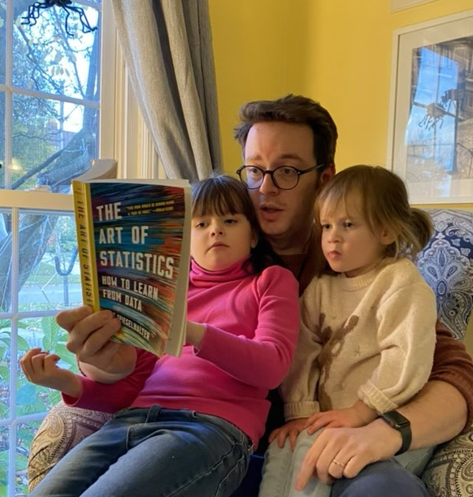
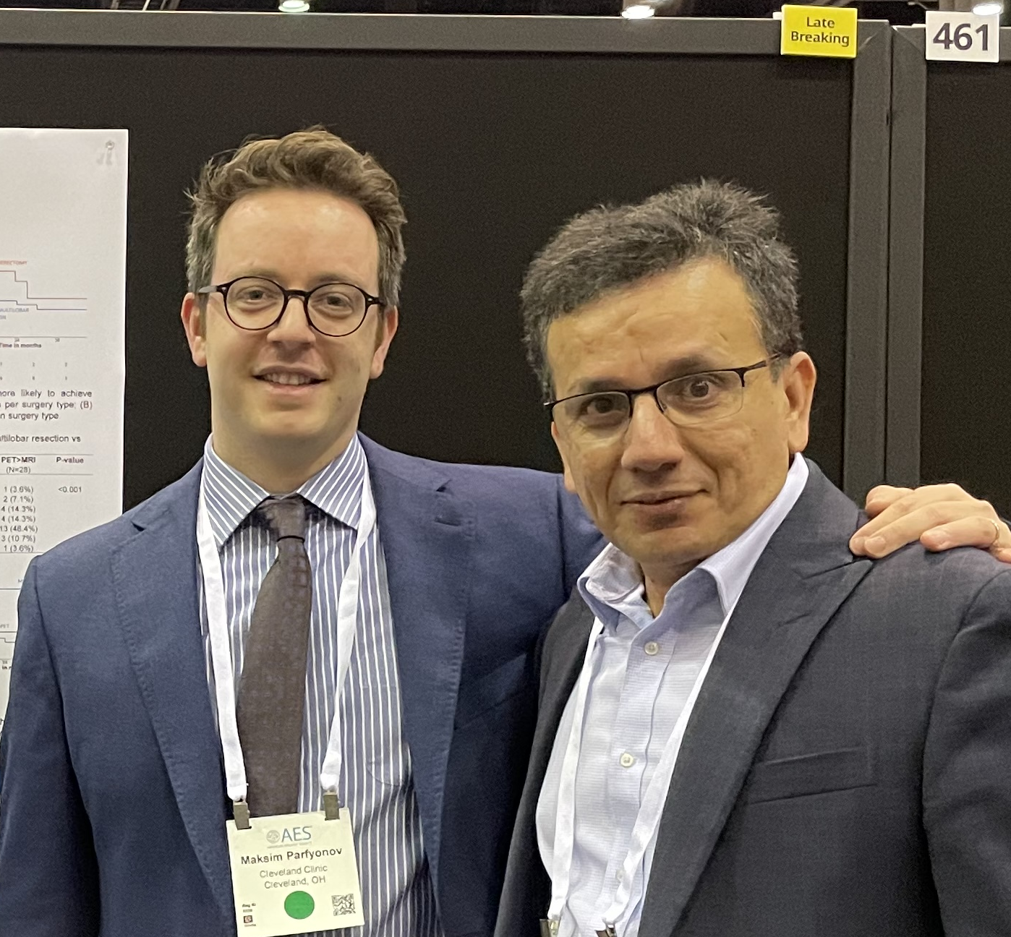
Acknowledgements
Peter Sarnacki
Hyunjun Ahn
Moosa Naduvil
Elia Pestana-Knight
Prakash Kotagal
Deepak Lachhwani
Bill Bingaman
Doksu Moon
Matthew Poturalski
Data analysis team

Slide 36
References
1. Phung J, Krogstad P, Mathern GW. Etiology associated with developing posthemispherectomy hydrocephalus after resection-disconnection procedures. J Neurosurg Pediatr. 2013;12(5):469-475. doi:10.3171/2013.8.PEDS13212
2. Moosa ANV, Jehi L, Marashly A, et al. Long-term functional outcomes and their predictors after hemispherectomy in 115 children. Epilepsia. 2013;54(10):1771-1779. doi:10.1111/epi.12342
3. Bulacio JC, Jehi L, Wong C, et al. Long-term seizure outcome after resective surgery in patients evaluated with intracranial electrodes. Epilepsia. 2012;53(10):1722-1730. doi:10.1111/j.1528-1167.2012.03633.x
4. Hemispherectomy for treatment of refractory epilepsy in the pediatric age group: a systematic review in: Journal of Neurosurgery: Pediatrics Volume 15 Issue 1 (2015) Journals. Accessed April 23, 2023. https://thejns.org/pediatrics/view/journals/j-neurosurg-pediatr/15/1/article-p34.xml
5. Morino M, Shimizu H, Ohata K, Tanaka K, Hara M. Anatomical analysis of different hemispherotomy procedures based on dissection of cadaveric brains. J Neurosurg. 2002;97(2):423-431. doi:10.3171/jns.2002.97.2.0423
6. Hemispherectomy for treatment of refractory epilepsy in the pediatric age group: a systematic review in: Journal of Neurosurgery: Pediatrics Volume 15 Issue 1 (2015) Journals. Accessed April 23, 2023. https://thejns.org/pediatrics/view/journals/j-neurosurg-pediatr/15/1/article-p34.xml
7. Wyllie E, Lachhwani DK, Gupta A, et al. Successful surgery for epilepsy due to early brain lesions despite generalized EEG findings. Neurology. 2007;69(4):389-397. doi:10.1212/01.wnl.0000266386.55715.3f
8. Wyllie E. Wyllie’s Treatment of Epilepsy: Principles and Practice. Lippincott Williams & Wilkins; 2020.
9. Alotaibi F, Albaradie R, Almubarak S, Baeesa S, Steven DA, Girvin JP. Hemispherotomy for Epilepsy: The Procedure Evolution and Outcome. Can J Neurol Sci. 2021;48(4):451-463. doi:10.1017/cjn.2020.216
10. Zentner J. Reoperations After Failed Resective Surgery. In: Zentner J, ed. Surgical Treatment of Epilepsies: Diagnosis, Surgical Strategies, Results. Springer International Publishing; 2020:245-252. doi:10.1007/978-3-030-48748-5_12
11. Rizzi M, Revay M, d’Orio P, et al. Tailored multilobar disconnective epilepsy surgery in the posterior quadrant. Journal of Neurosurgery. 2019;132(5):1345-1357. doi:10.3171/2019.1.JNS183103
12. Kogias E, Bast T, Schubert-Bast S, et al. Multilobar Epilepsy Surgery in Childhood and Adolescence: Predictors of Long-Term Seizure Freedom. Neurosurgery. 2020;88(1):174-182. doi:10.1093/neuros/nyaa368
13. Lew SM. Hemispherectomy in the treatment of seizures: a review. Transl Pediatr. 2014;3(3):208-217. doi:10.3978/j.issn.2224-4336.2014.04.01
14. Holthausen H, Coras R, Tang Y, et al. Multilobar unilateral hypoplasia with emphasis on the posterior quadrant and severe epilepsy in children with FCD ILAE Type 1A. Epilepsia. 2022;63(1):42-60. doi:10.1111/epi.17114
15. Ramantani G, Strobl K, Stathi A, et al. Reoperation for Refractory Epilepsy in Childhood: A Second Chance for Selected Patients. Neurosurgery. 2013;73(4):695. doi:10.1227/NEU.0000000000000081
16. Kim SK, Wang KC, Hwang YS, et al. Epilepsy surgery in children: outcomes and complications. PED. 2008;1(4):277-283. doi:10.3171/PED/2008/1/4/277
17. Daniel RT, Meagher-Villemure K, Farmer JP, Andermann F, Villemure JG. Posterior Quadrantic Epilepsy Surgery: Technical Variants, Surgical Anatomy, and Case Series. Epilepsia. 2007;48(8):1429-1437. doi:10.1111/j.1528-1167.2007.01095.x
18. Nilsson DT, Malmgren K, Flink R, Rydenhag B. Outcomes of multilobar resections for epilepsy in Sweden 1990–2013: a national population-based study. Acta Neurochir. 2016;158(6):1151-1157. doi:10.1007/s00701-016-2807-3
19. Kang JW, Eom S, Hong W, et al. Long-term Outcome of Resective Epilepsy Surgery in Patients With Lennox-Gastaut Syndrome. Pediatrics. 2018;142(4):e20180449. doi:10.1542/peds.2018-0449
20. Moosa ANV, Gupta A, Jehi L, et al. Longitudinal seizure outcome and prognostic predictors after hemispherectomy in 170 children. Neurology. 2013;80(3):253-260. doi:10.1212/WNL.0b013e31827dead9

Slide 37
Appendix

